Slide 1
Real-Time Age & Gender Detection using Jetson Nano
-Tejaswini Veeramachaneni
-Sruthi Velpula

Slide 2
Problem Statement
Airport Security Monitoring Challenges:
Airports handle high passenger traffic, making manual monitoring difficult
Lack of real-time automated age and gender analysis
Manual methods are time-consuming and prone to errors
Cloud-based solutions introduce latency and privacy concerns
Need for a fast, edge-based AI system for airport security

Slide 3
Project Objective:
Design a real-time system to detect age and gender of passengers
Implement an edge-based AI solution using Jetson Nano
Reduce latency and privacy risks by avoiding cloud processing
Support airport security and crowd monitoring applications
Demonstrate a practical and scalable computer vision system

Slide 4
System Architecture
Input: USB camera captures live video frames
Face Detection: Haar Cascade detects faces in each frame
Centroid Tracking: assigns a unique ID to each detected face across frames
People Counting: count = number of tracked IDs (unique people)
Preprocessing: convert face ROI to blob (227×227)
Inference Models:
  GenderNet → Male/Female
  AgeNet → age range bucket
Output: show bounding box + ID + age + gender + people count on live video

Slide 5
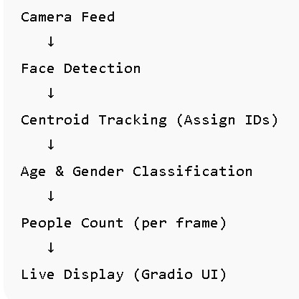
Workflow
Capture live video frames using a USB camera
Detect faces in each frame using Haar Cascade classifier
Apply Centroid Tracking algorithm to track faces across frames
Assign a unique ID to each detected person and count total people
Extract face region of interest (ROI) for each tracked person
Preprocess face images to the required input size (227 × 227)
Perform age and gender prediction using deep learning models
Display bounding box, ID, age, gender, and people count on live video

Slide 6
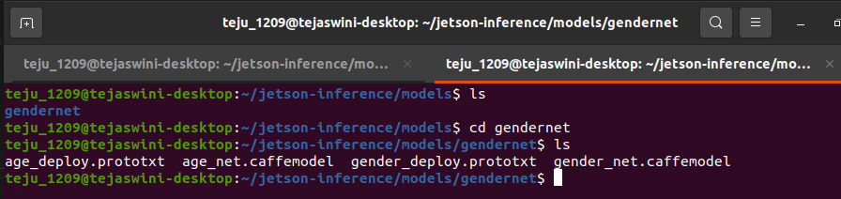
Models Used
AgeNet
  Deep learning model for predicting age range
  Outputs age in predefined age group buckets
GenderNet
  Deep learning model for gender classification
  Outputs Male or Female
Both models are Caffe-based pre-trained models
Models loaded and executed using OpenCV DNN module
Optimized for real-time inference on Jetson Nano

Slide 7
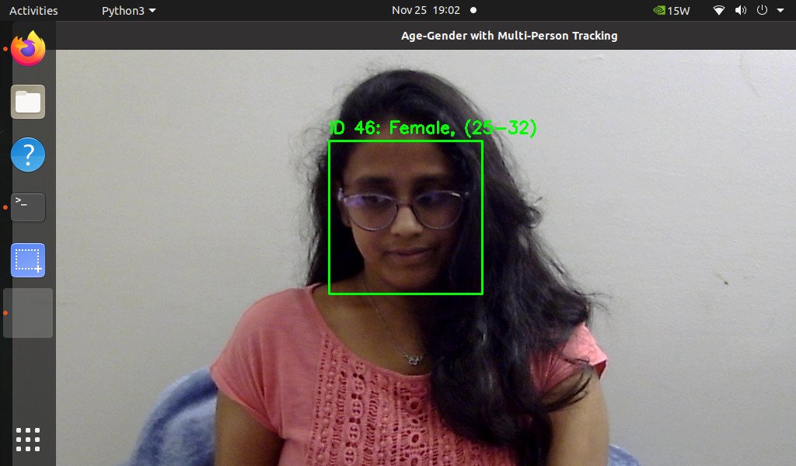
Centroid Tracking Algorithm
Centroid tracking is a object tracking technique used to detected faces across video frames.
Lightweight, fast, and suitable for real-time applications .
The center point (centroid) of the bounding box is calculated for each detected faces.
If no matching centroid is found, the algorithm assigns a new ID to that face.
Prevents counting the same person multiple times by remembering the past faces with ID.

Slide 8
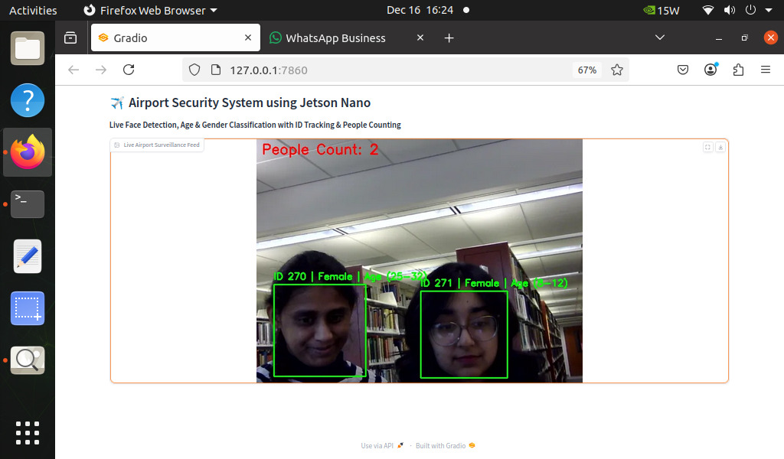
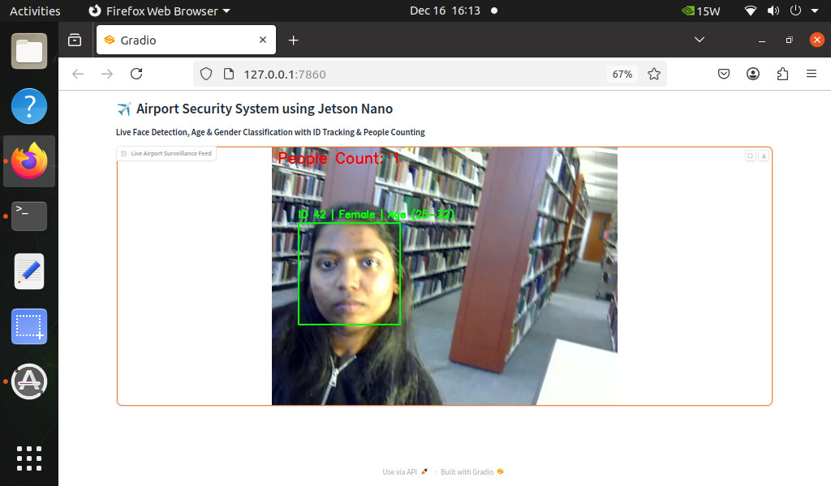
Result

Slide 9


